Slide 1
DRONE (COPTER-TYPE) AND ARDUPILOT
Presented By NHân

Slide 2
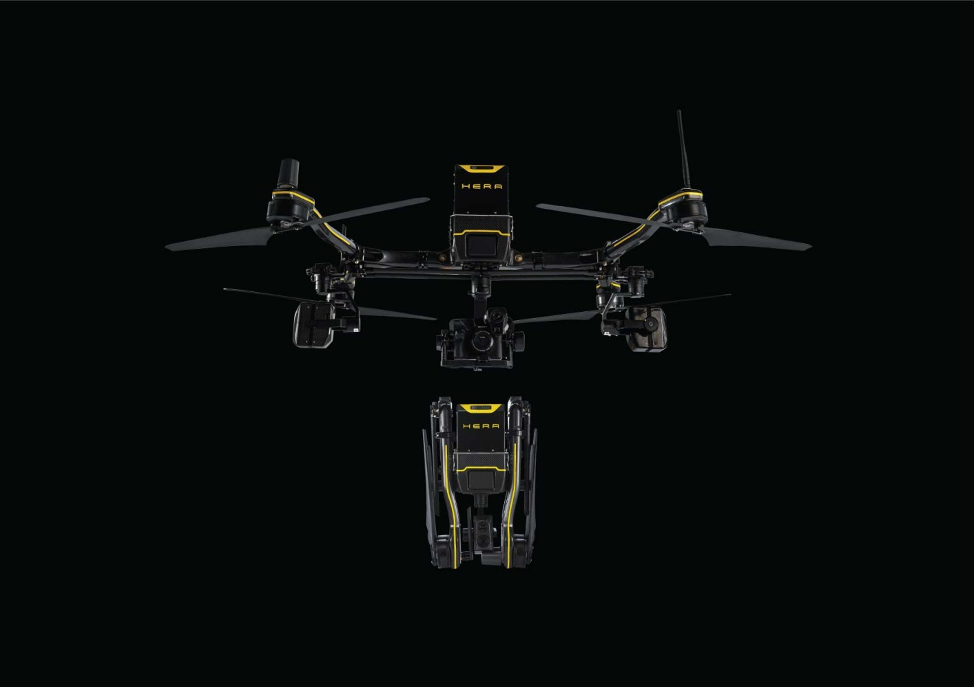
I. Drone.
Drone definition and classification.
Copter configuration.
Copter-type drone principle.
Basic structure.
Motor control and ESC.
Sensors/receivers.
Flight controllers and companion computers.

Slide 3
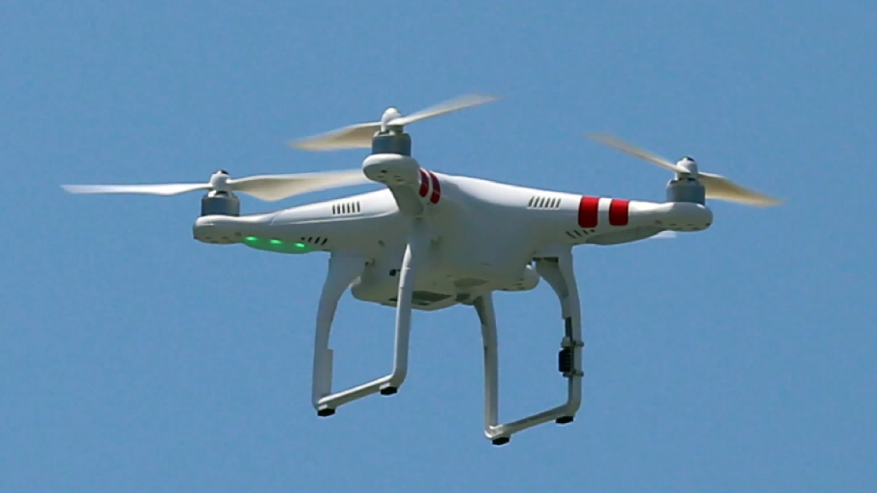
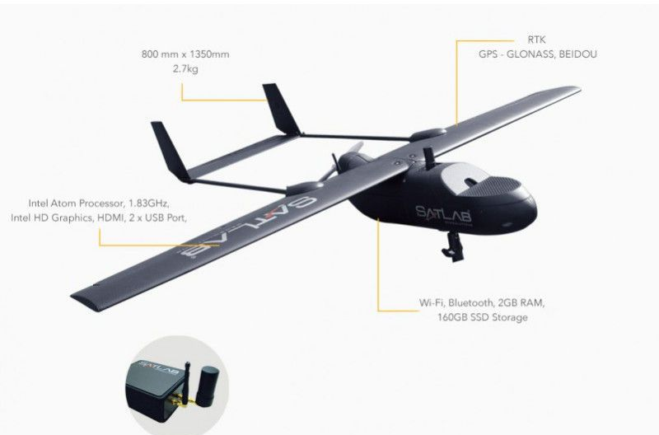
DRONE DEFINITION AND CLASSIFICATION
Copter-based drone:
Aeroplane-based drone (fixed-wing drone):
Drones are defined as aircrafts without any human pilot, crew, or passengers onboard.

Slide 4
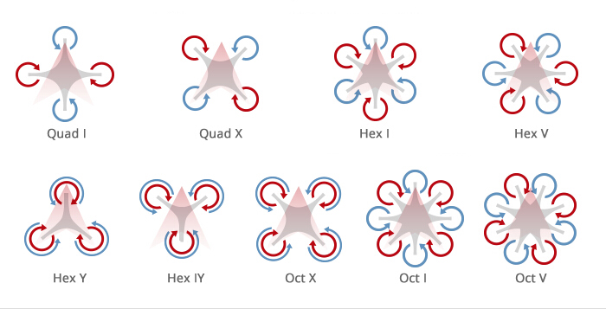
COPTER CONFIGURATION

Slide 5
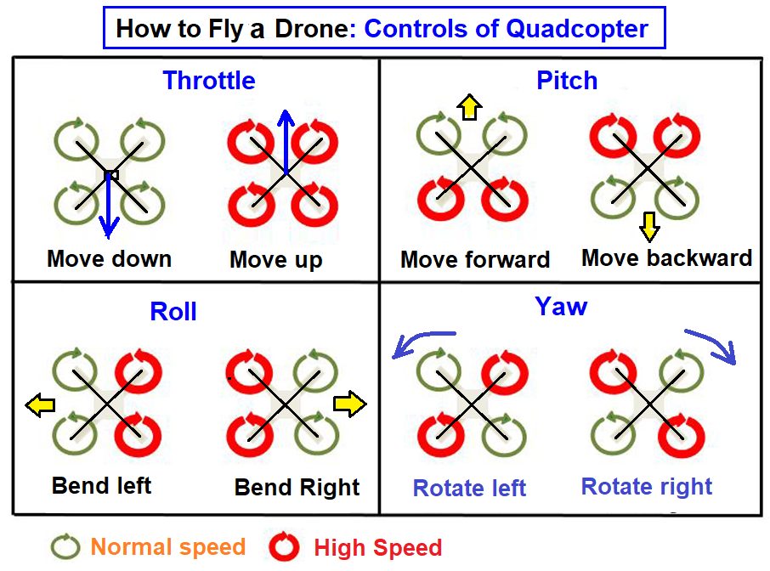
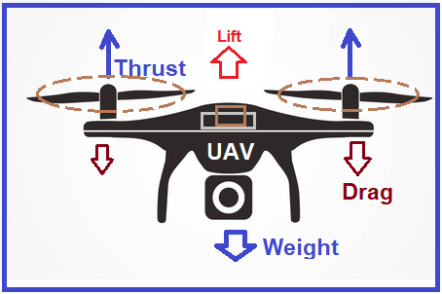
COPTER-TYPE (4 MOTORS) PRINCIPLE

Slide 6
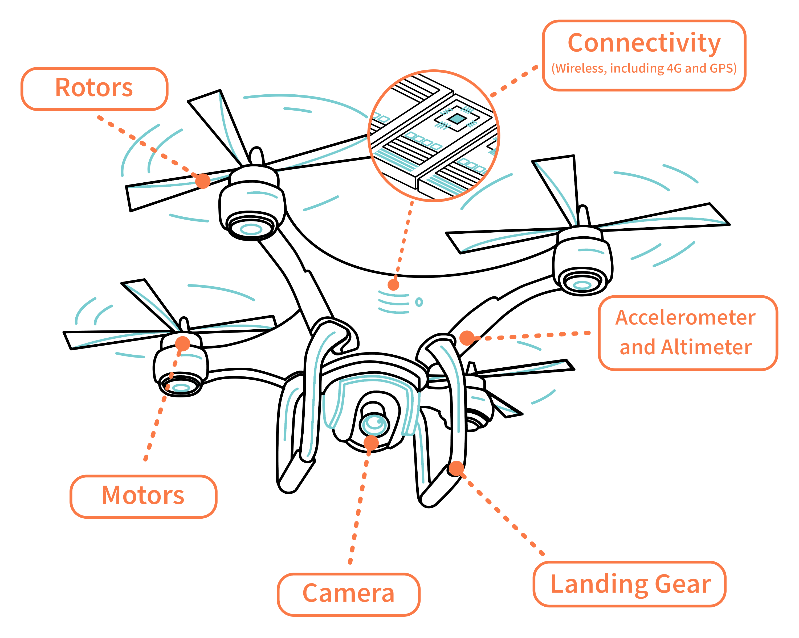
BASIC STRUCTURE

Slide 7
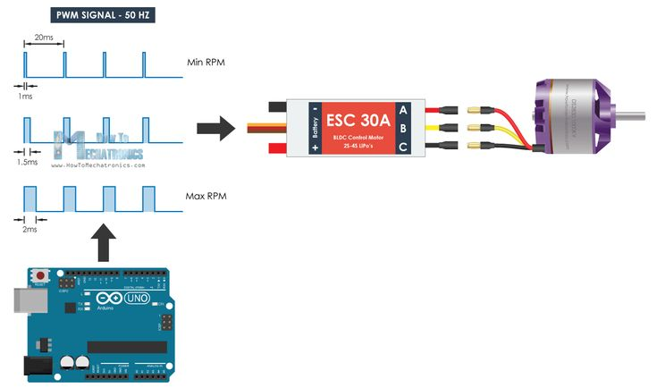
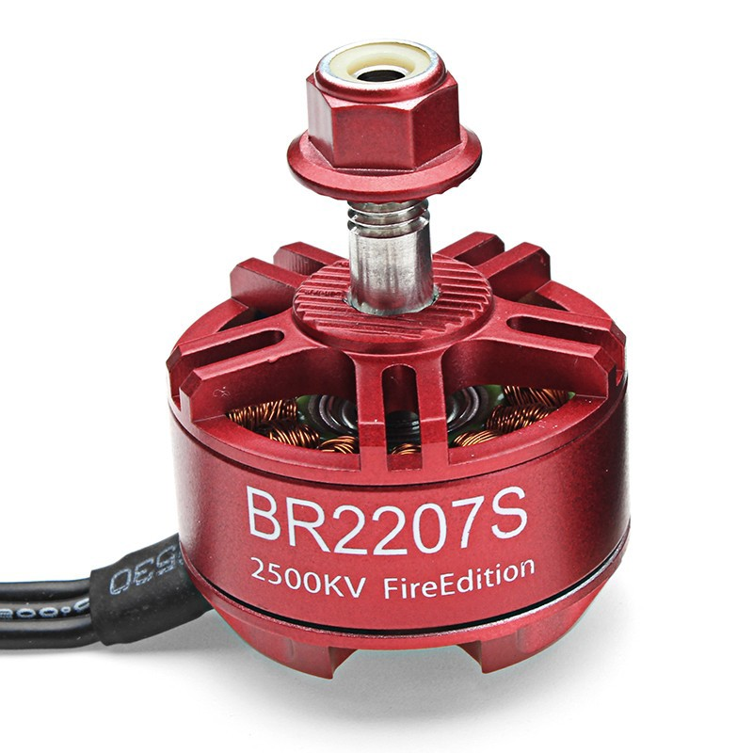
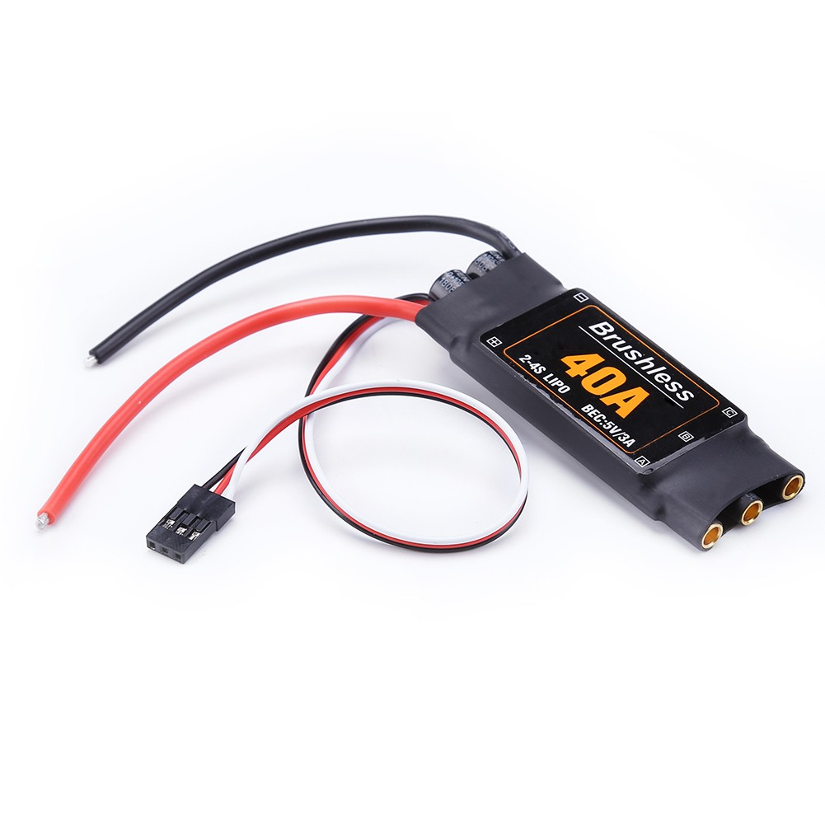
MOTOR CONTROL
DC 3-phase brushless motors.
ESCs are used as a medium to control motors from flight controller.
ESC protocol: PWM, Oneshot, DSHOT, Multishot,...

Slide 8
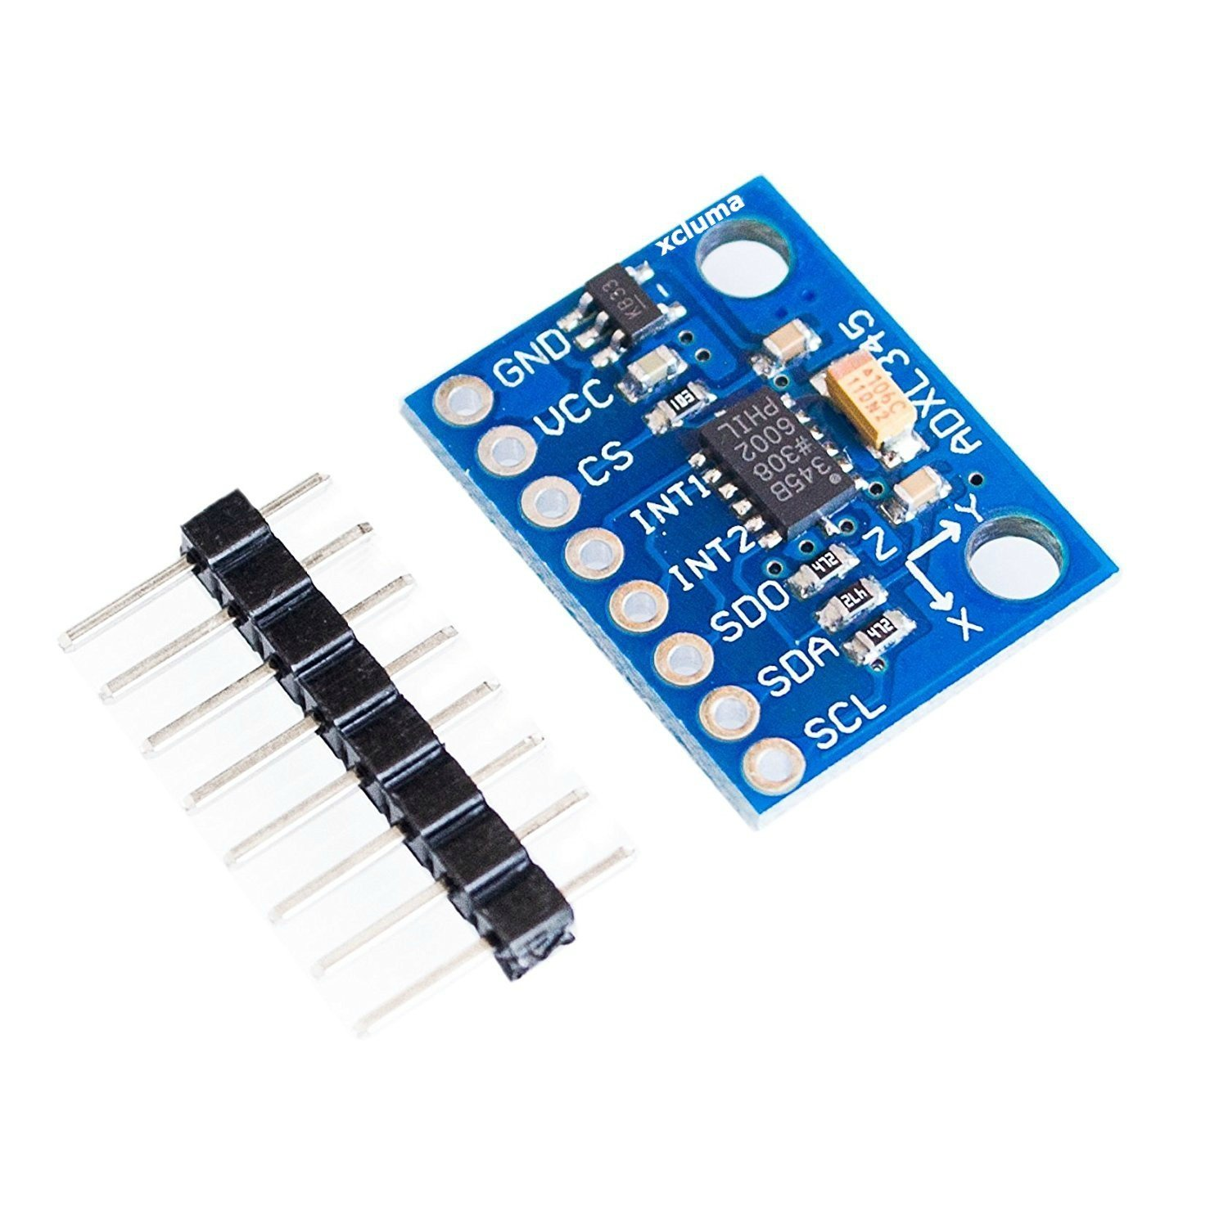
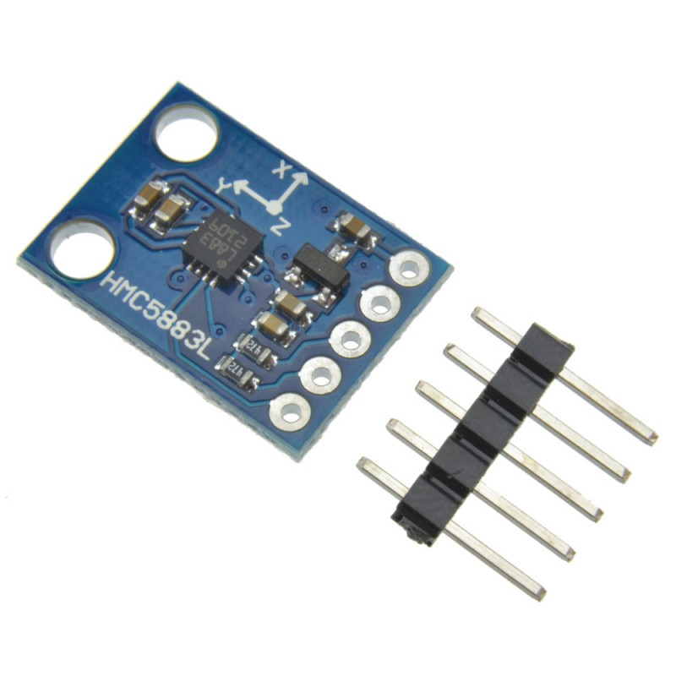
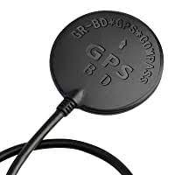
SENSORS/RECEIVER
Accelerometer & Gyrometers: Measure tilt angle, acceleration (velocity can also be derived from acceleration signal).
Antenna: Receive control signal from users via RC/wifi (telemetry in general).
GPS (optional): Locate global position of the robot (longitude, latitude).
Barometer: Measure (high) altitude of the robot.
Camera: Capture picture and video for instant processing using AI or collecting data.
Compass (optional): Determine drone direction.
IR camera/sensor (optional): Human detection.
LIDAR: Altitude hold and object avoidance.

Slide 9
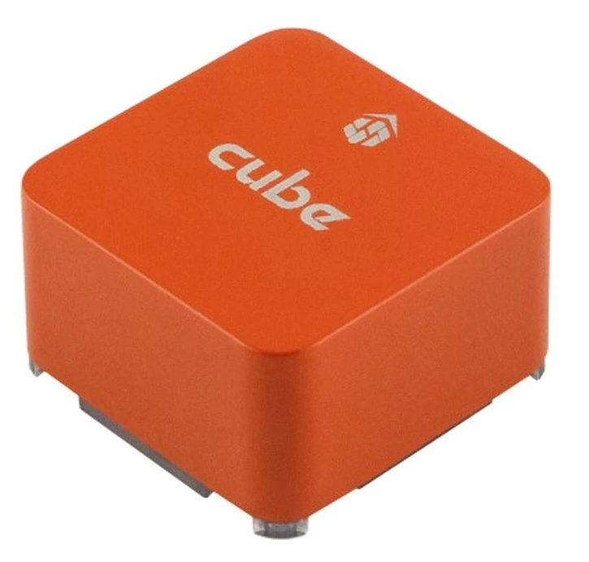
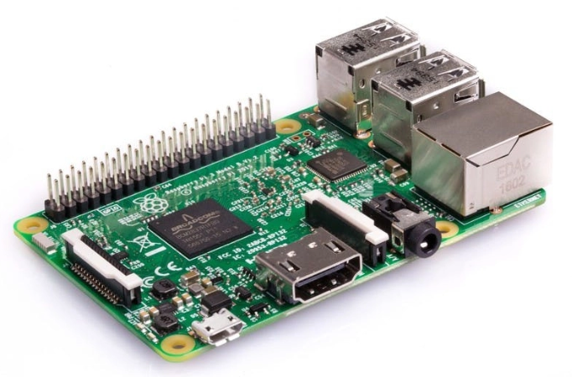
FLIGHT CONTROLLER AND COMPANION COMPUTER
Flight controller:
Main processor of the drone.
Read input value from the sensor and return output signal to control motors and servos.
Communicate with ground control station.
Companion computer (microcontrollers with telemetry connection are mainly used):
Execute AI task (optional) using camera image/IR camera/IR sensor input.
Determine trajectory for the drone.

Slide 10
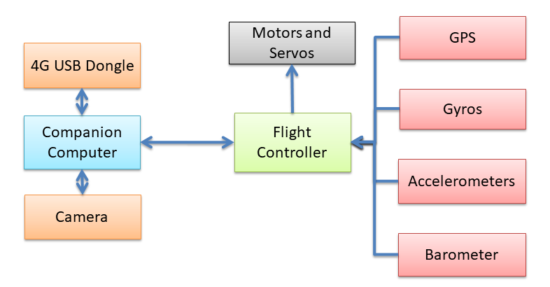
DRONE CONTROL DIAGRAM

Slide 11
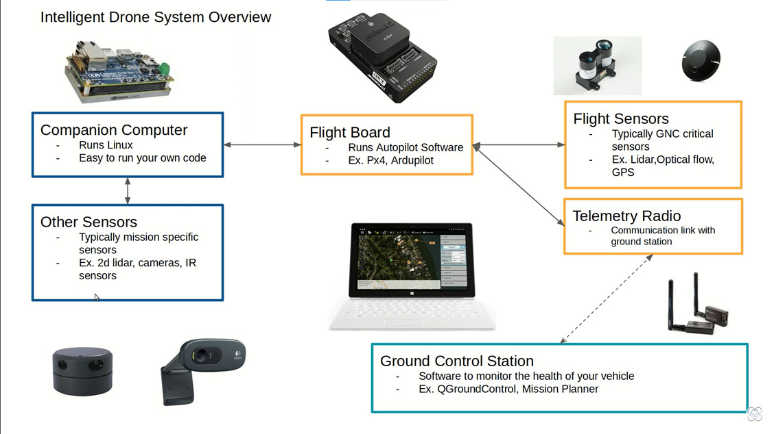

Slide 12

II. ArduPilot
ArduPilot is a trusted, versatile, and open source autopilot system supporting many vehicle types: multi-copters, traditional helicopters, fixed wing aircraft, boats, submarines, rovers and more.
ArduPilot architecture for copter-type drone.
ArduPilot functionalities.
2.1. Firmware.
2.2. Software.
2.3. Simulation.
2.4. Unmanned vehicles.
2.5. Ground control stations.

Slide 13
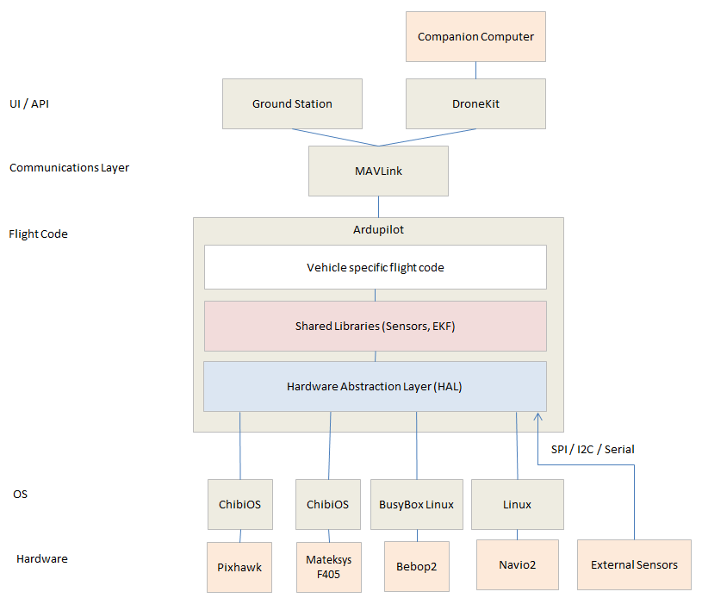
ARDUPILOT ARCHITECTURE FOR COPTER-TYPE DRONE

Slide 14
ARDUPILOT FUNCTIONALITIES
Firmware: Help to communicate with peripherals and allow developers to calibrate them.
Software: Combined with applications such as Mission Plannar or X Plane, ArduPilot can provide a GUI for control.
Simulation: Virtual hardwares are available for developers to test their code before experimenting on real model.
Unmanned vehicles: Support multiple configuration of copters and other unmanned vehicles.
Ground control stations: Supports piloting process and streaming live video and data to the control center.

Slide 15
FIRMWARE
ArduPilot provides a variety of libraries supporting multiple widely-used peripherals including:
Accelerometers.
Gyroscopes.
Barometer.
GPS.
Compass.
Motors/servos.
and more...

Slide 16
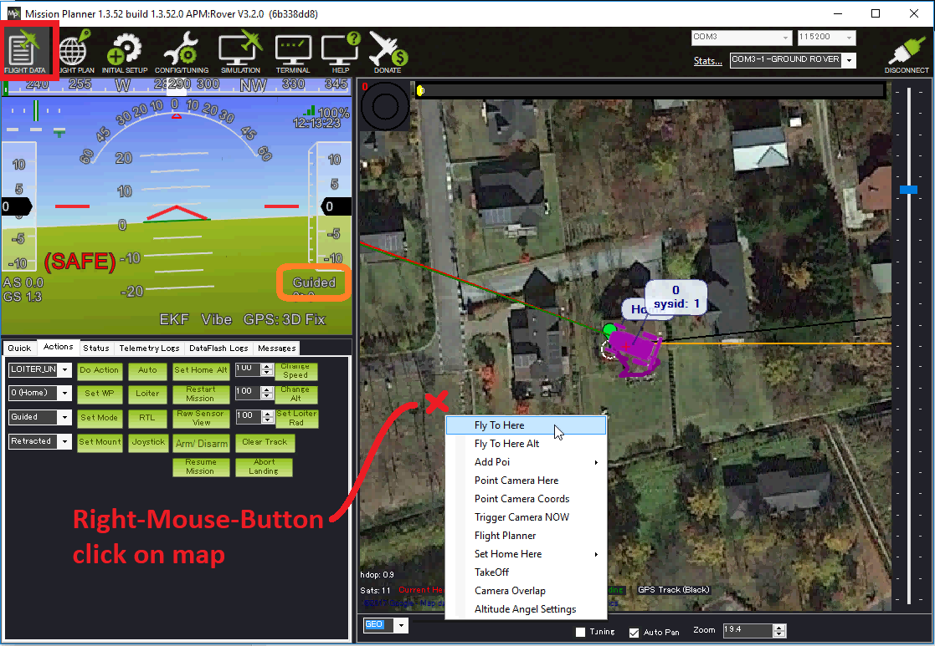
SOFTWARE

Slide 17
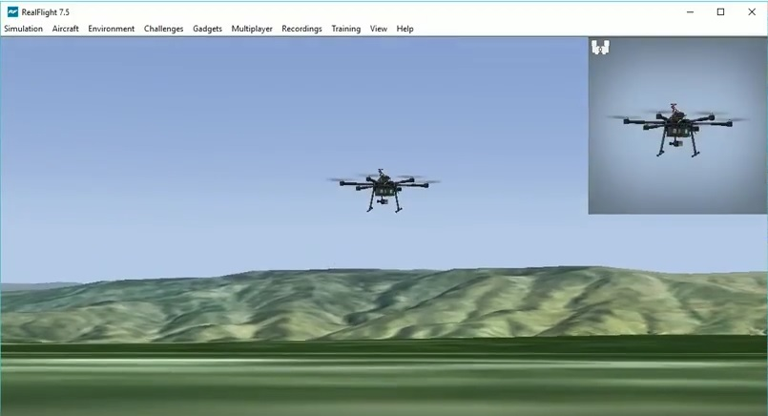
SIMULATION

Slide 18
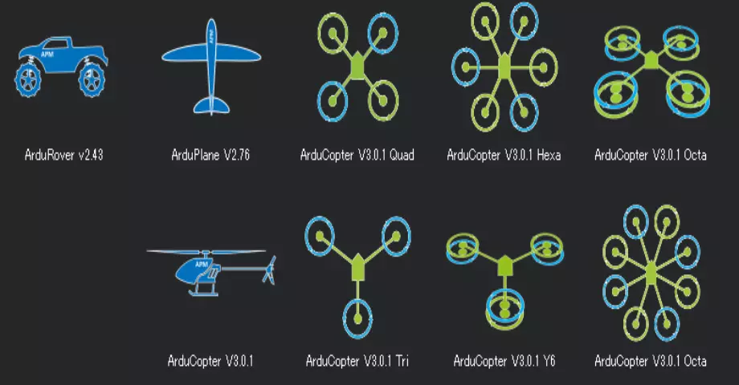
UNMANNED VEHICLES

Slide 19
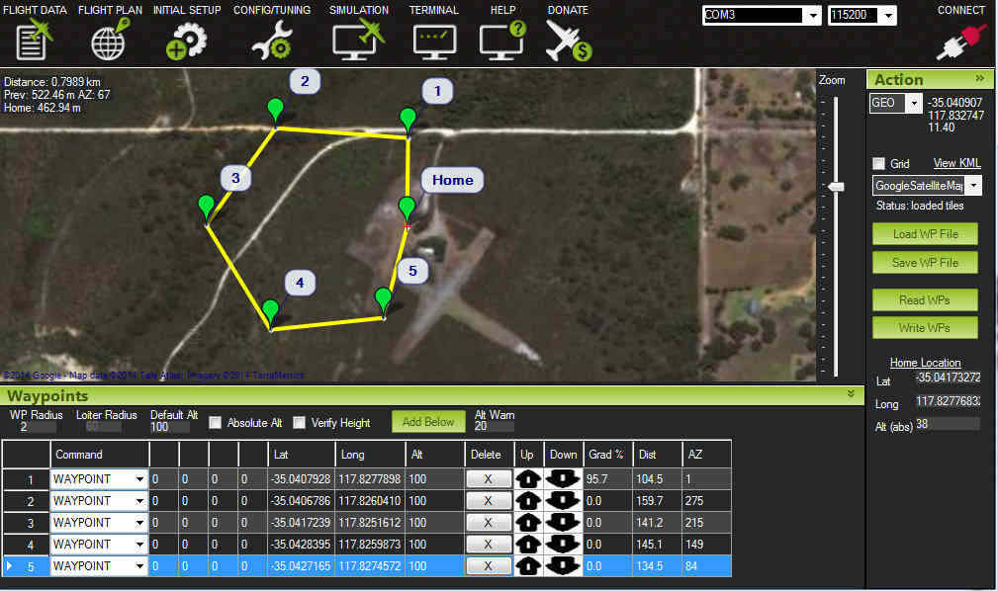
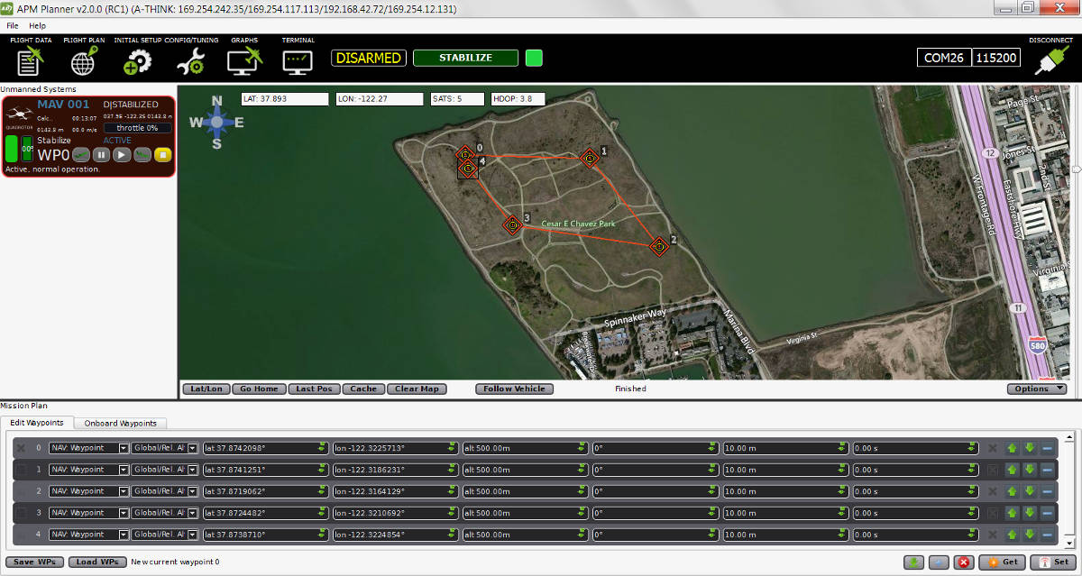
GROUND CONTROL STATION

Slide 20

III. Real-time Robotics
Hardware.
1.1. Frame manufacturing.
1.2. Self-design boards and battery packaging.
Firmwares.
Software - GUI.
AI.

Slide 21

FRAME MANUFACTURING
The outer parts of the drone’s body are self-crafted using carbon fiber as the main materials. For experimental models, they are made by alluminium or 3D-printed.

Slide 22
SELF-DESIGNED BOARDS AND BATTERY PACKAGING
There are various boards and module here are self-designed:
- Extended boards for peripherals connecting to the flight controller.
- Compass module.
- BMS (Battery Management System) module.
Also, battery packs of the drone are also created here (including experimenting and grouping the batteries).

Slide 23
GPS optimization
Firmware
Motors (ESC) and sensors calibration
Battery management

Slide 24


